Slide 1
Trace Master Real-Time Facial Recognition and Case Management for Missing Person Recovery

Slide 2
Project Motivation
Every Lots of children and old aged persons are missing form their loved once and many of the cases are remaining unresolved .
The current systems for missing person identification are often slow, inefficient, and lack the precision needed for rapid action.
We wanted to apply AI for social good, ensuring ethical and impactful deployment. AI can bridge this gap.
My project is developed by using AI,ML,DL tools to search people , Ticket tracking system , user friendly usage with guidelines, notification based on tickets.

Slide 3
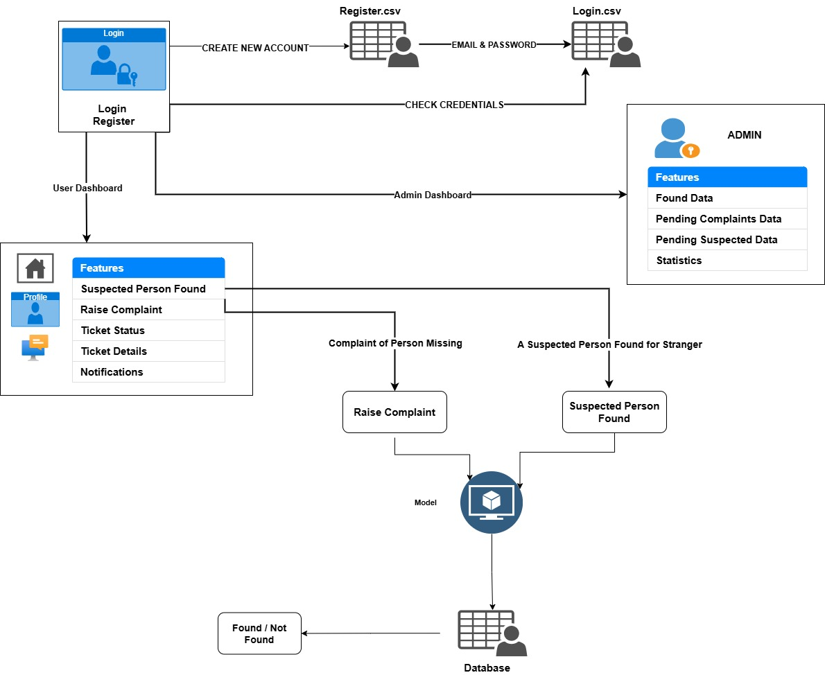
Flow Chart of Project

Slide 4
Algorithms Used
Face Recognition - Arch-Face , Insight Face- Buffalo-l models
Programming Language - Python
Frameworks – Numpy, Pandas, Tensorflow/Keras, Scikit-learn
Frontend - Html, CSS, JavaScript
Backend - Flask
Hardware and software configurations –
Processor : i5/intel or equivalent
RAM : 8GB (minimum).
CPU: High-performance CPUs and GPUs
Operating System: Windows 10 or higher

Slide 5
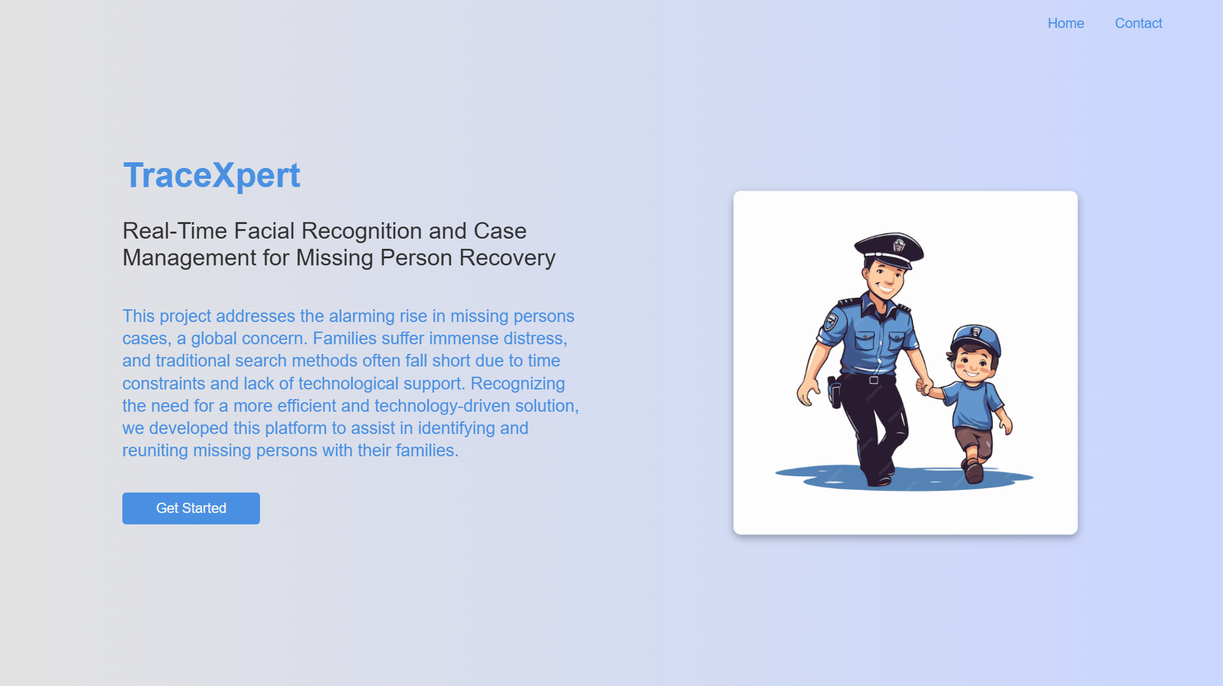
1.Home Page of Our Project

Slide 6

2.Login Page

Slide 7

3.Register Page

Slide 8

4.Enter the details and Verify your Mobile Number

Slide 9
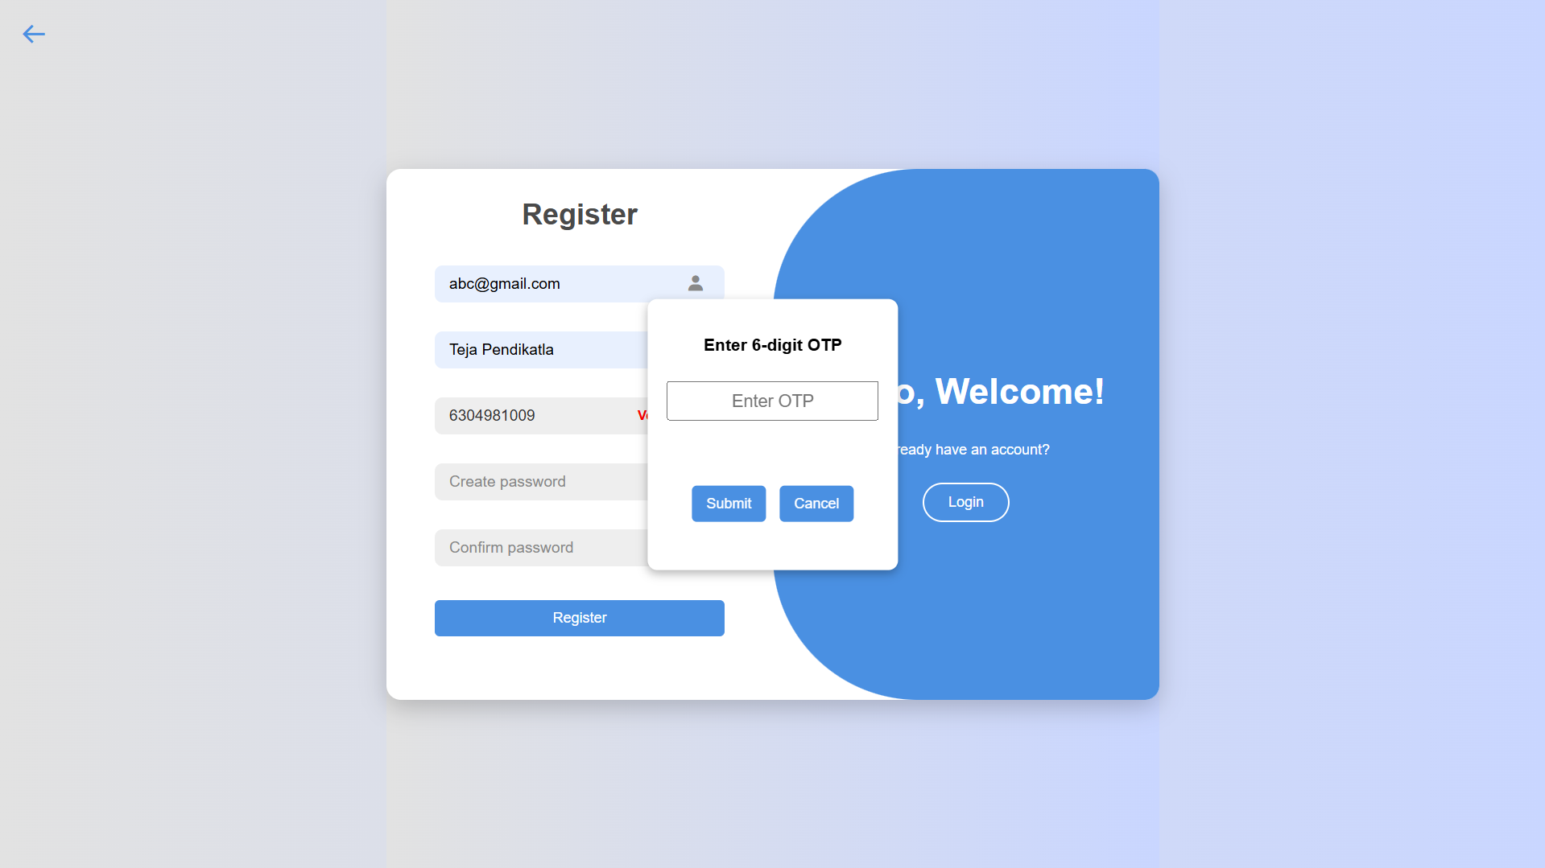
5.Enter the OTP & Click Submit

Slide 10

6. Mobile Number is Verified , Createpassword and Click Register

Slide 11

7. Registration Successful and redirected to login page

Slide 12

8. Enter Credentials and Click Login

Slide 13
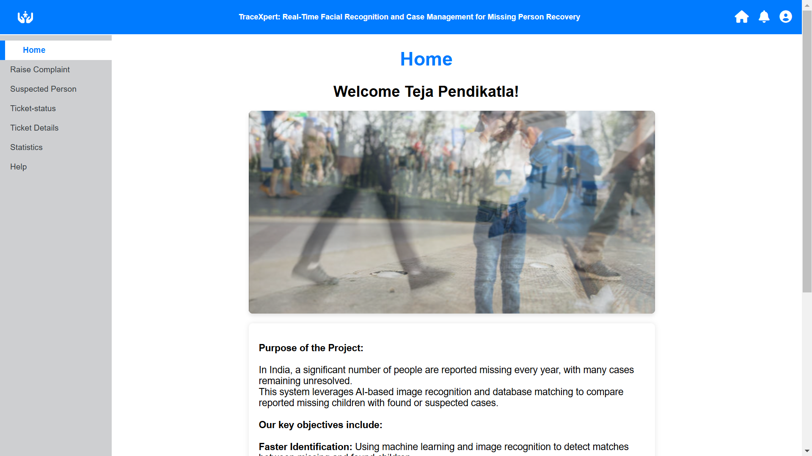
9. Redirected to User Dashboard

Slide 14
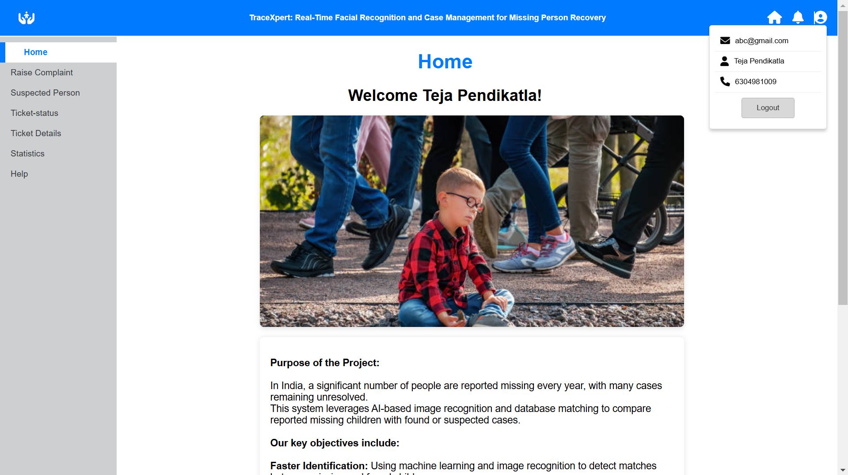
10.Click on profile icon to see details

Slide 15
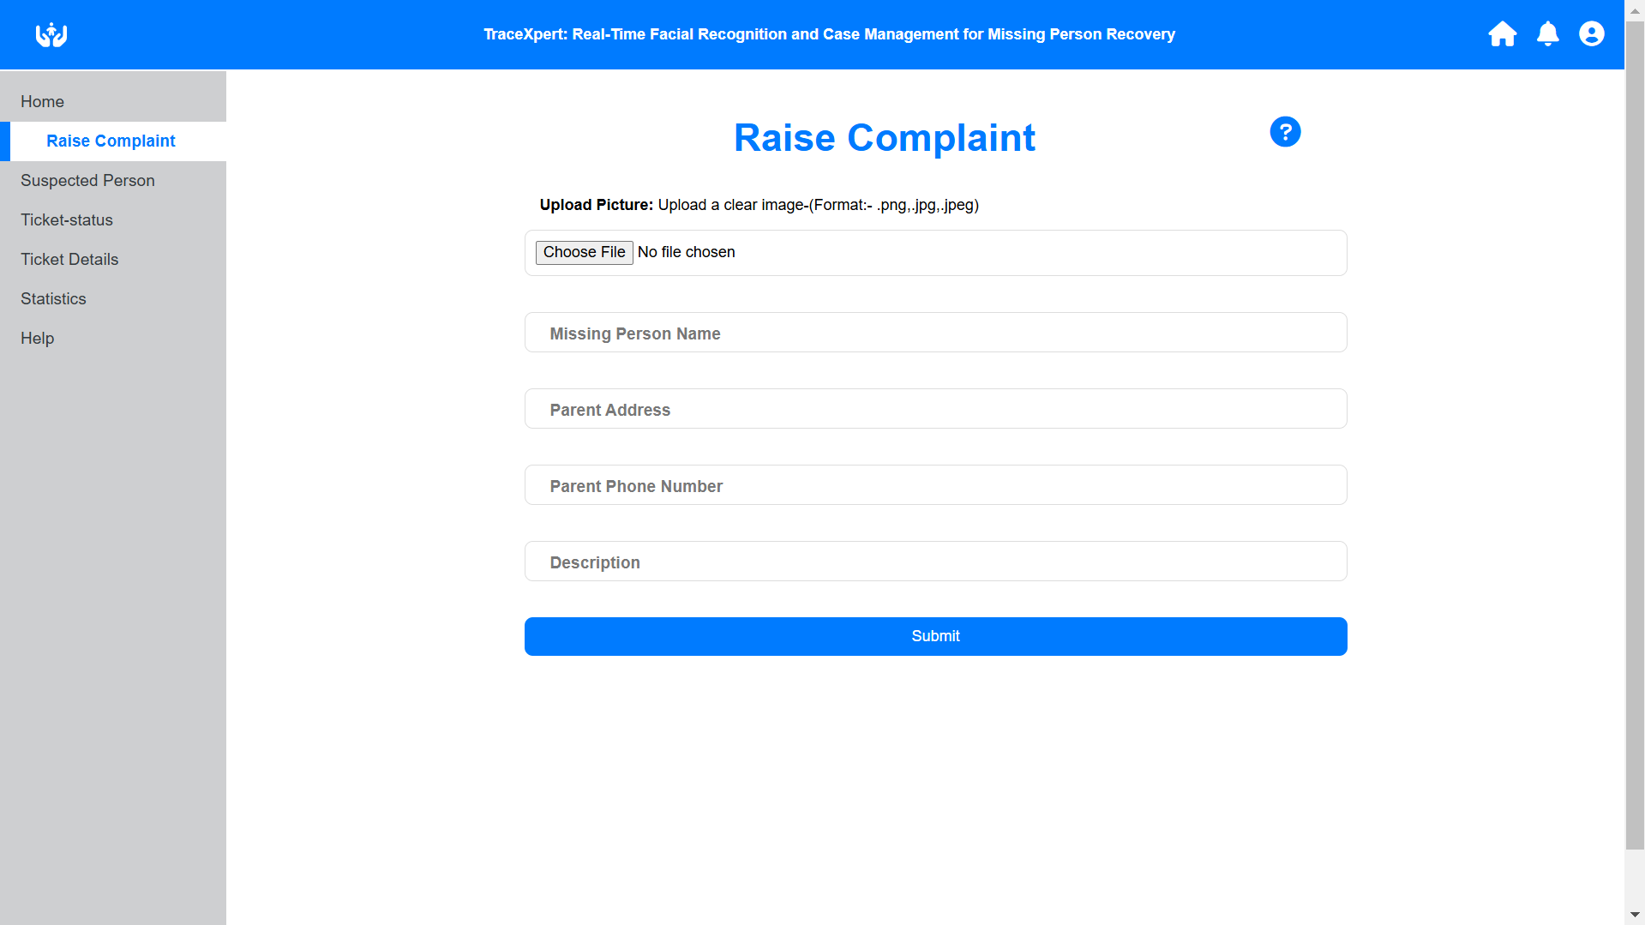
11. Complaints for a missing person are raised here.

Slide 16

12. Complaints for a suspected person found are raised here.

Slide 17
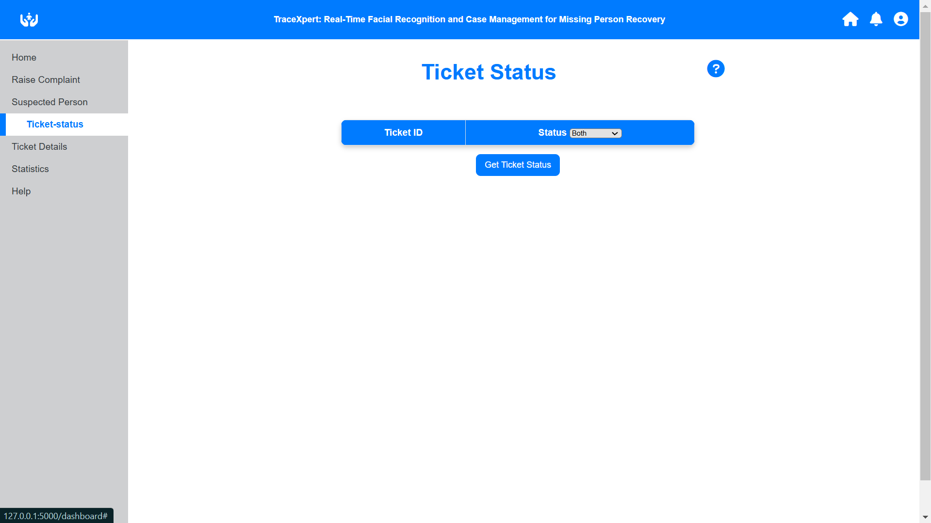
13. Checking the status of pending/completed tickets

Slide 18
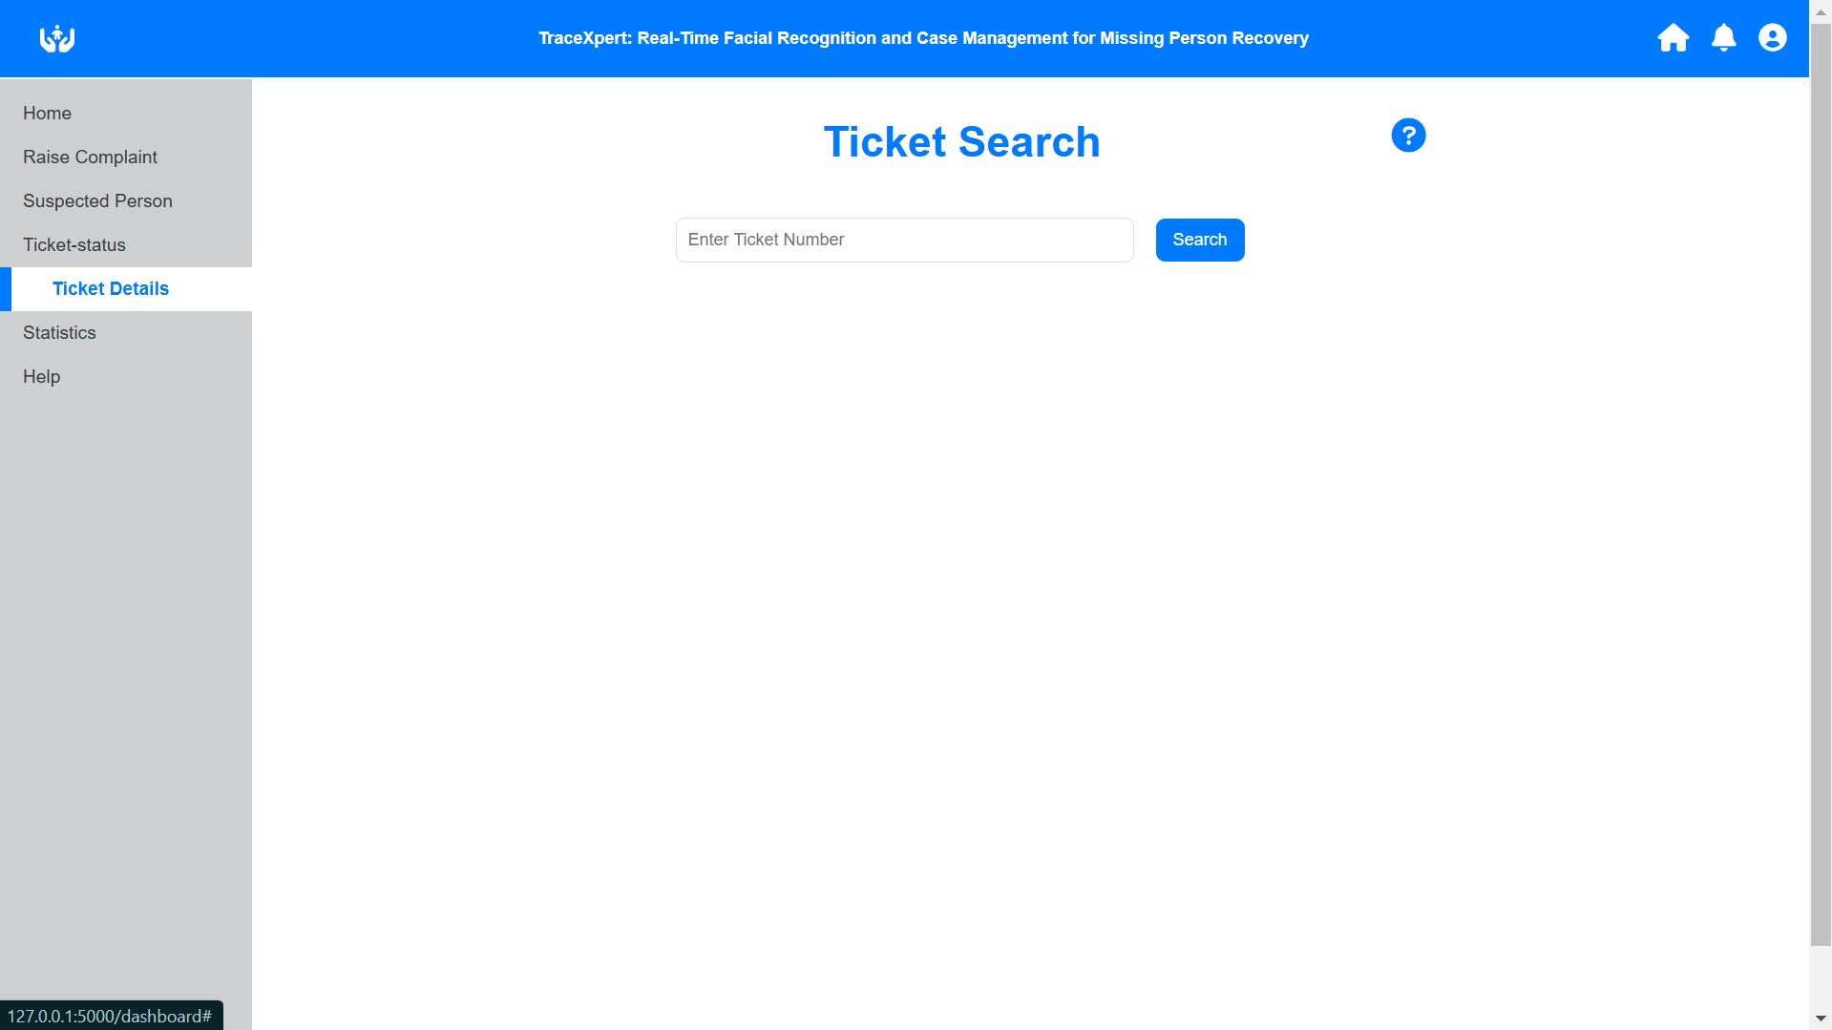
14.Search ticket details by ticket id

Slide 19
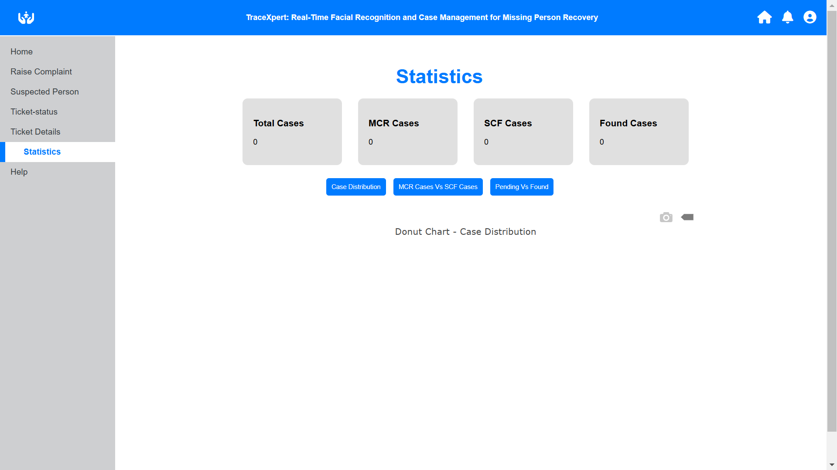
15. Statistics of user account

Slide 20
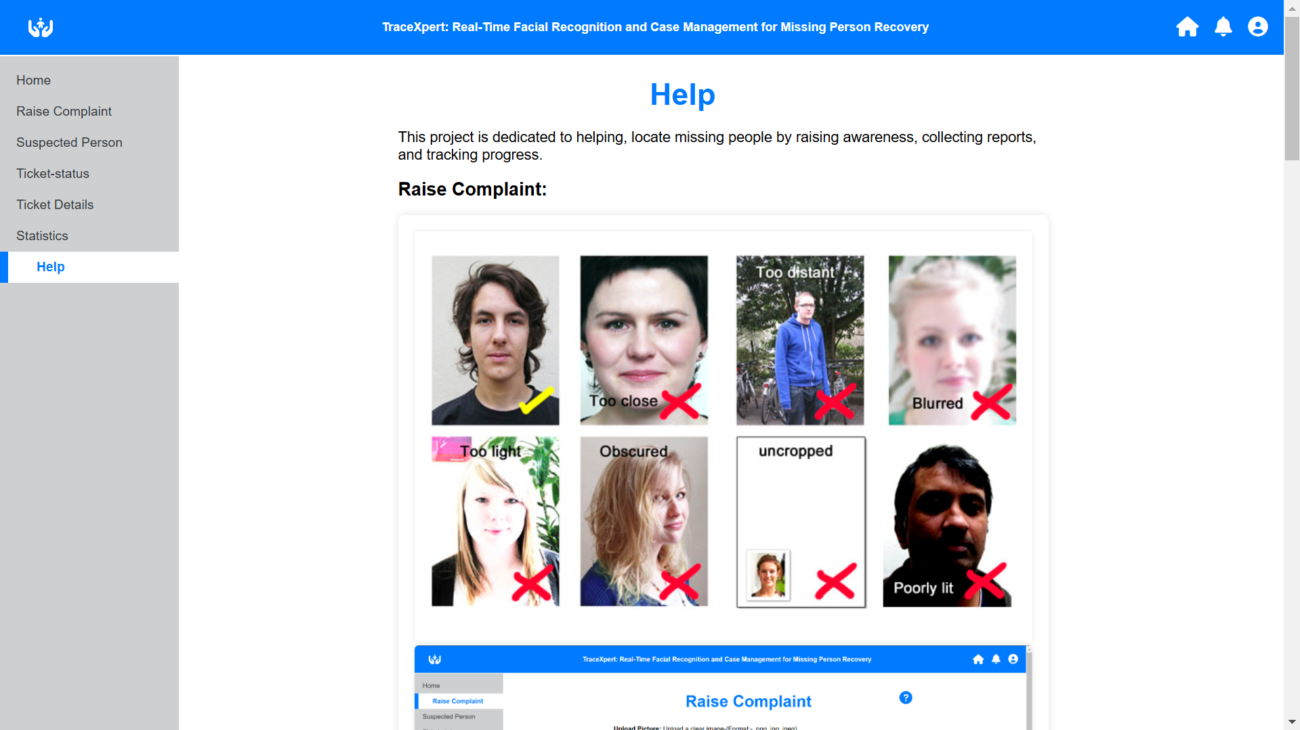
16. User manual for Trace-Master

Slide 21
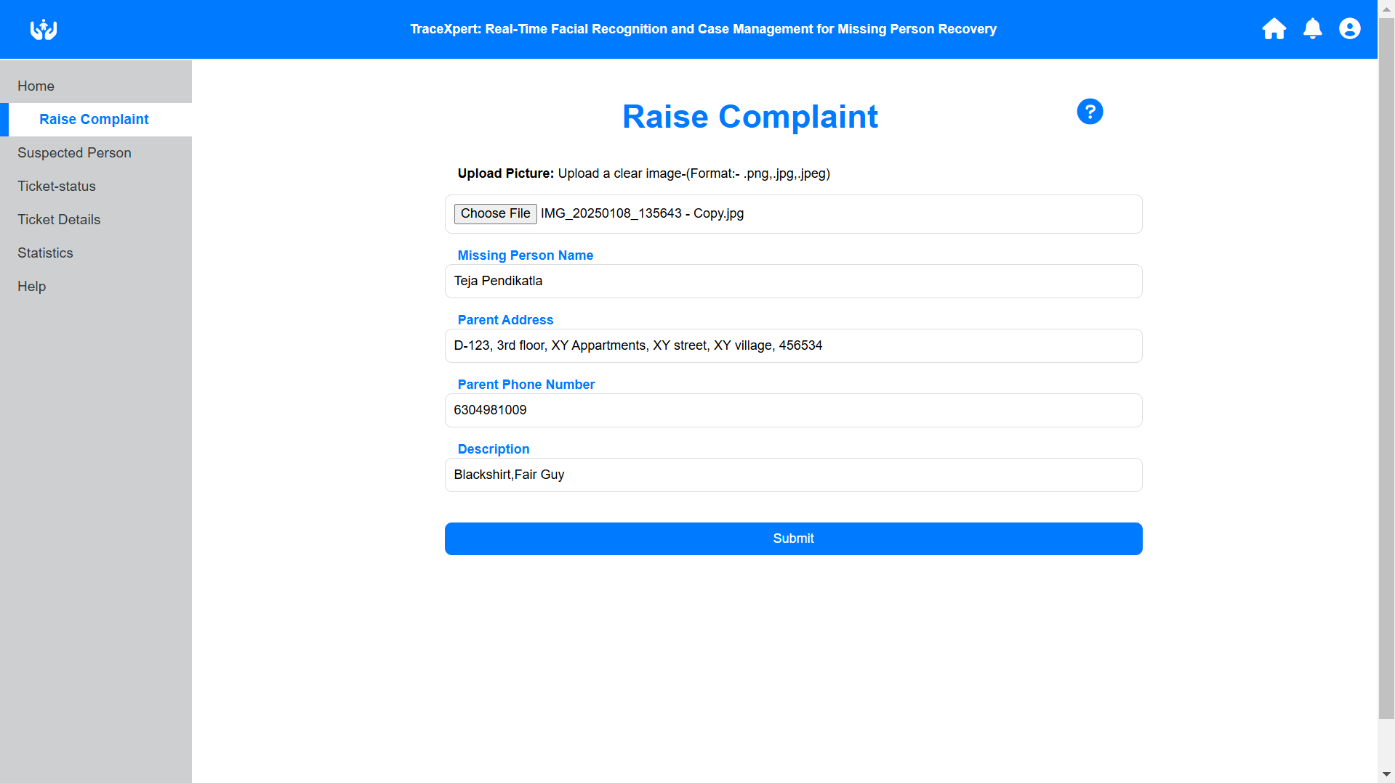
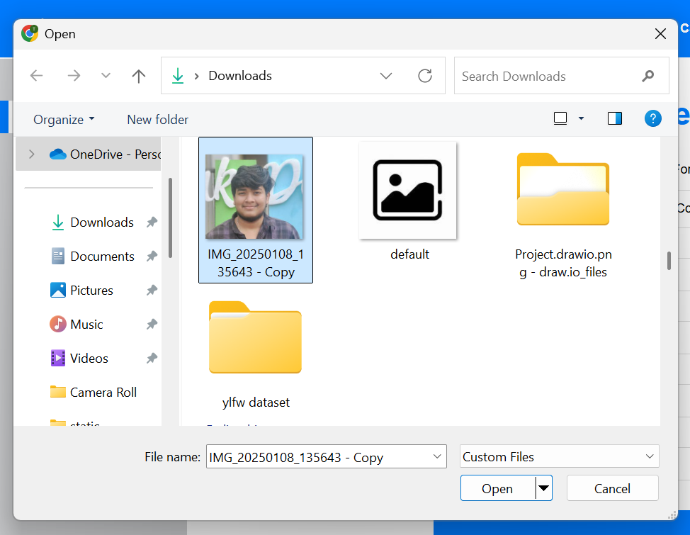
17. Fill the form and rasie a complaint for missing person

Slide 22
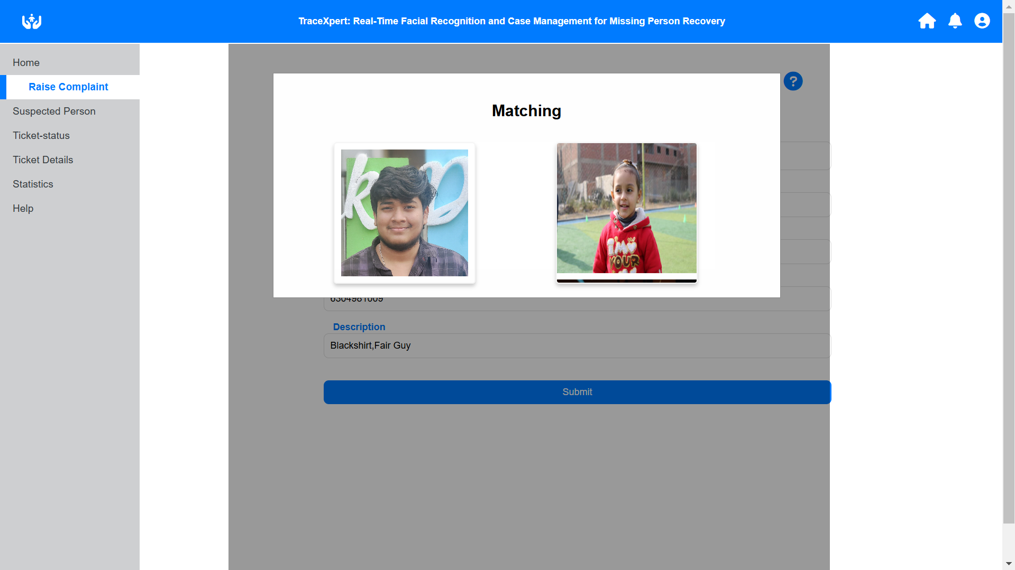
18. It will search in suspected persons data when a complaint raised

Slide 23
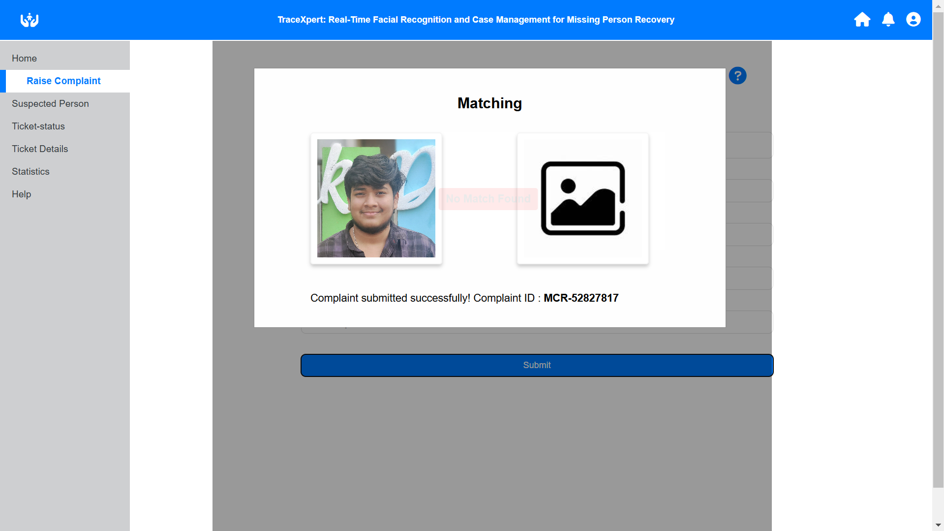
19.Macth Not Found for a person I uploaded & created MCR-xxxxxxxx

Slide 24
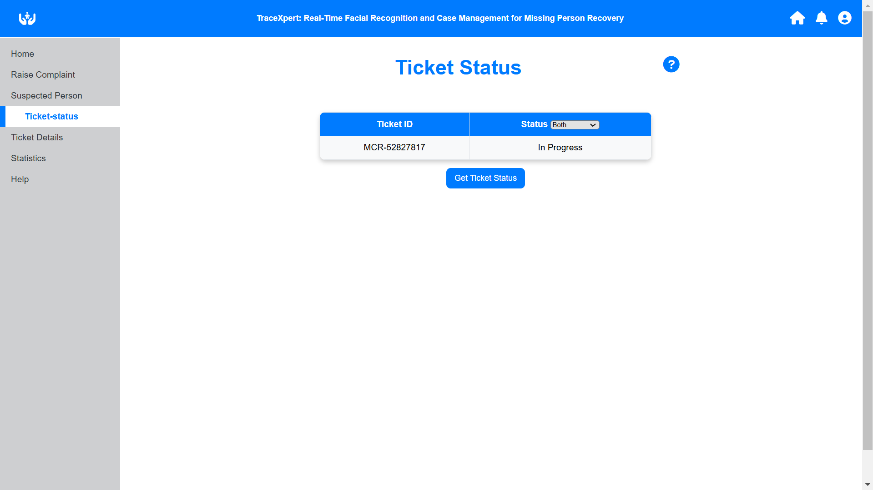
20. Check the status of ticket

Slide 25
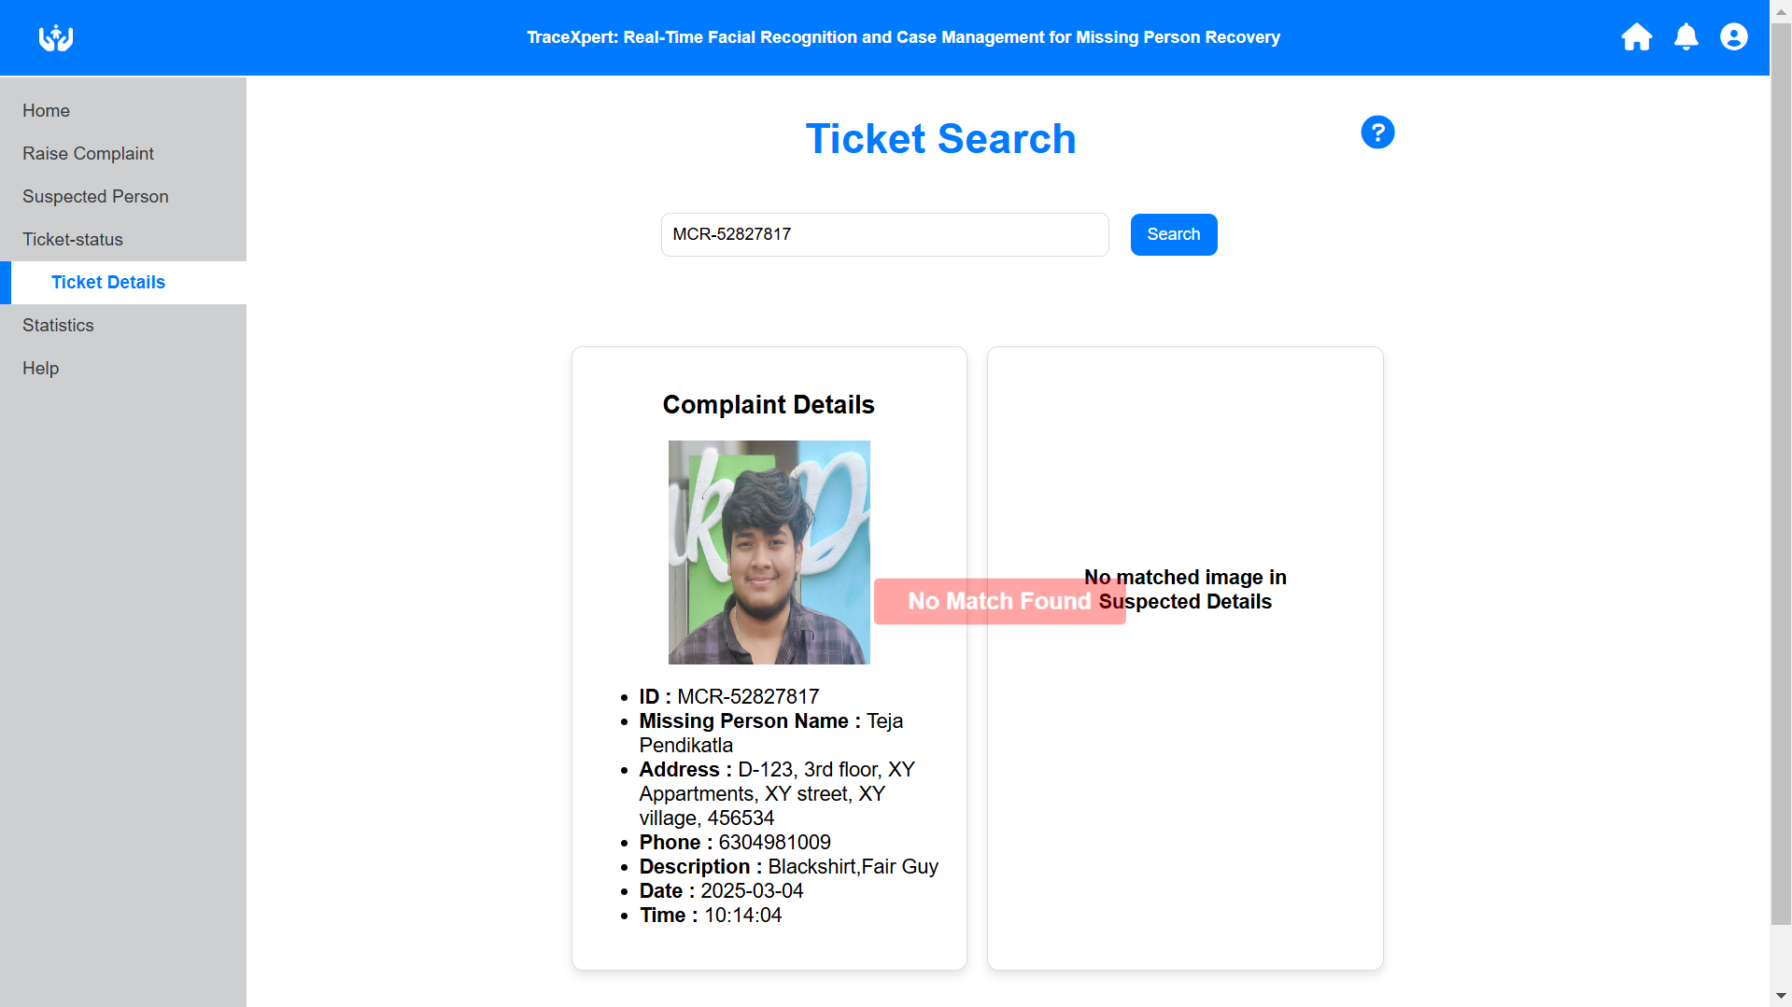
21.Search the ticket number here for more details about ticket

Slide 26
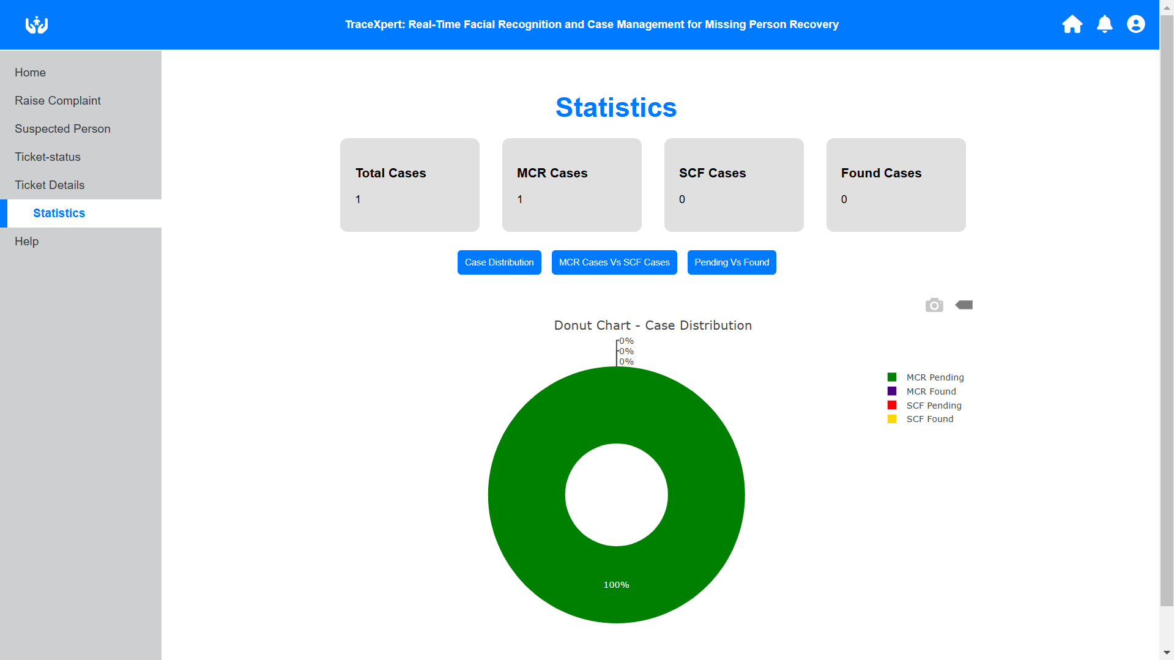
22.User statistics after this complaint

Slide 27
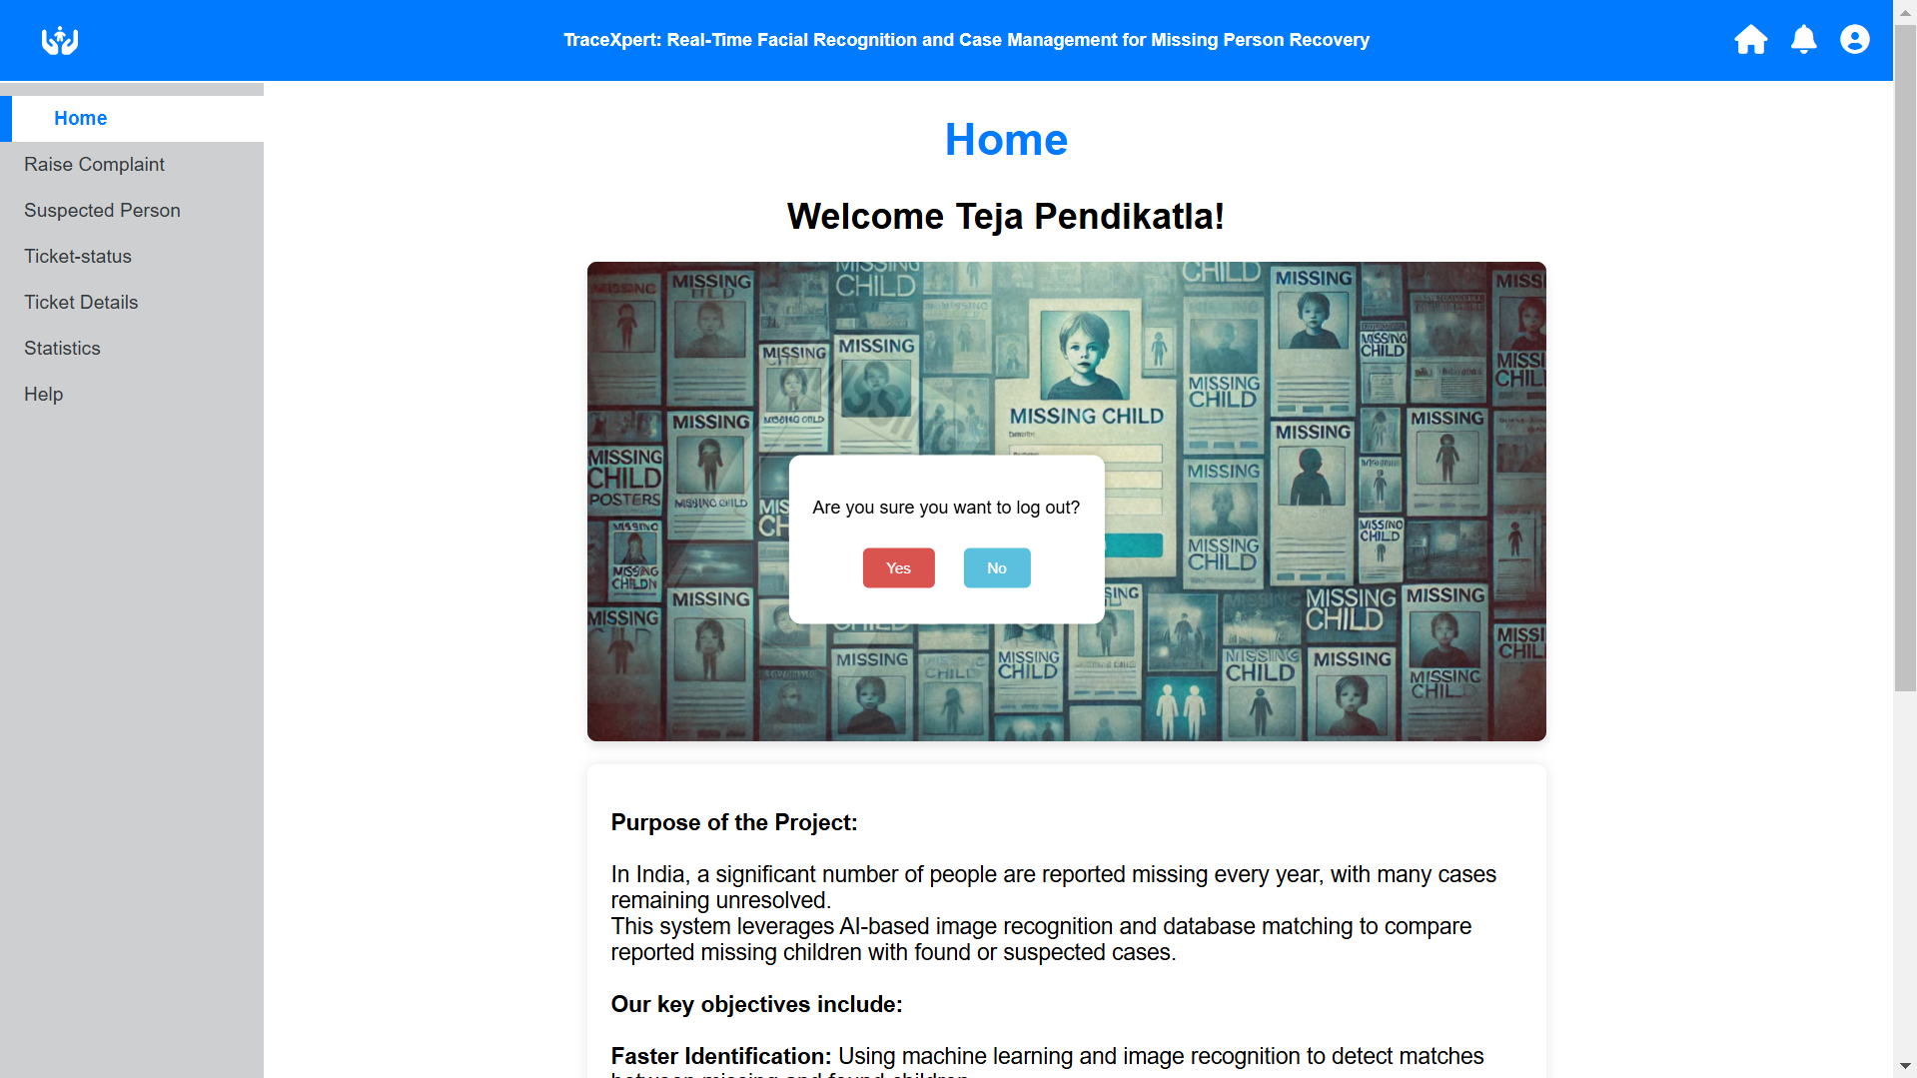
23.Click on logout in profile icon we get a popup for confirmation

Slide 28

24. Login with another account

Slide 29
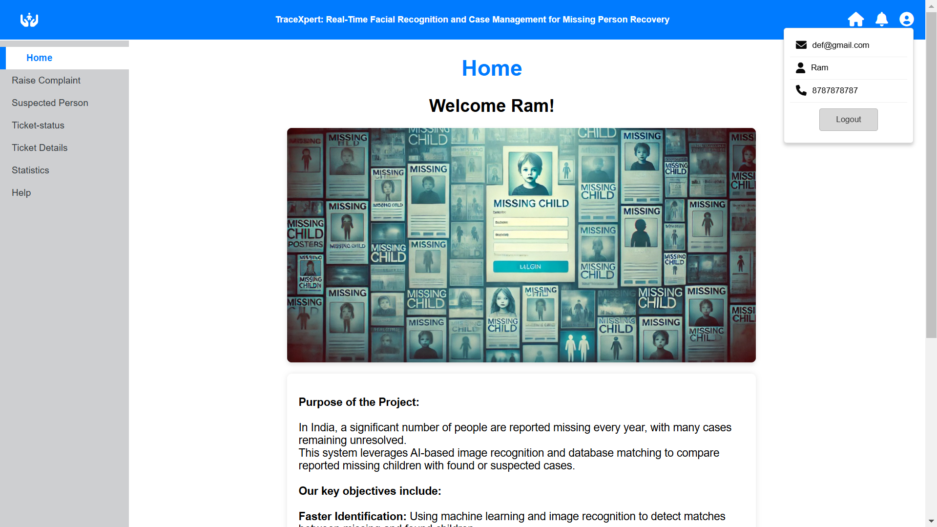
25. Click on profile to see the details of this account.

Slide 30
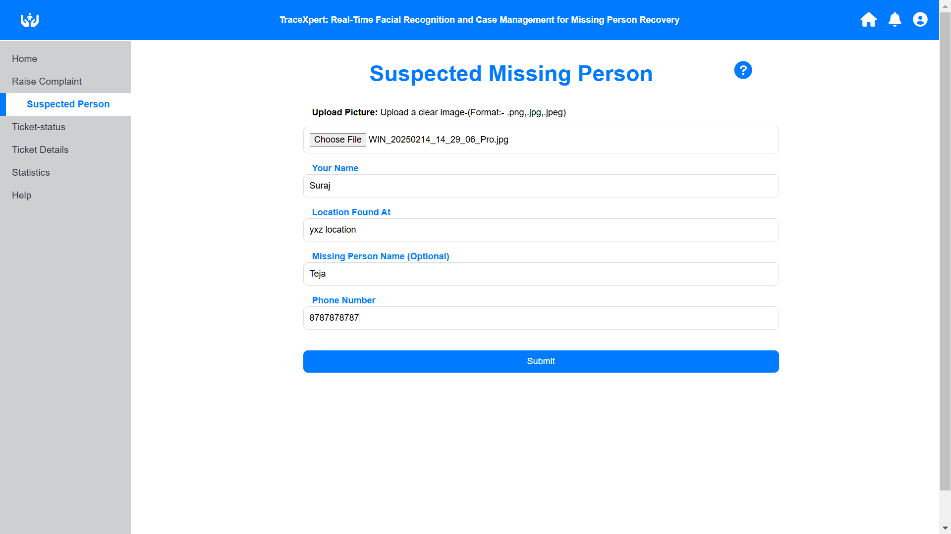
26. A suspected person found for a random man

Slide 31
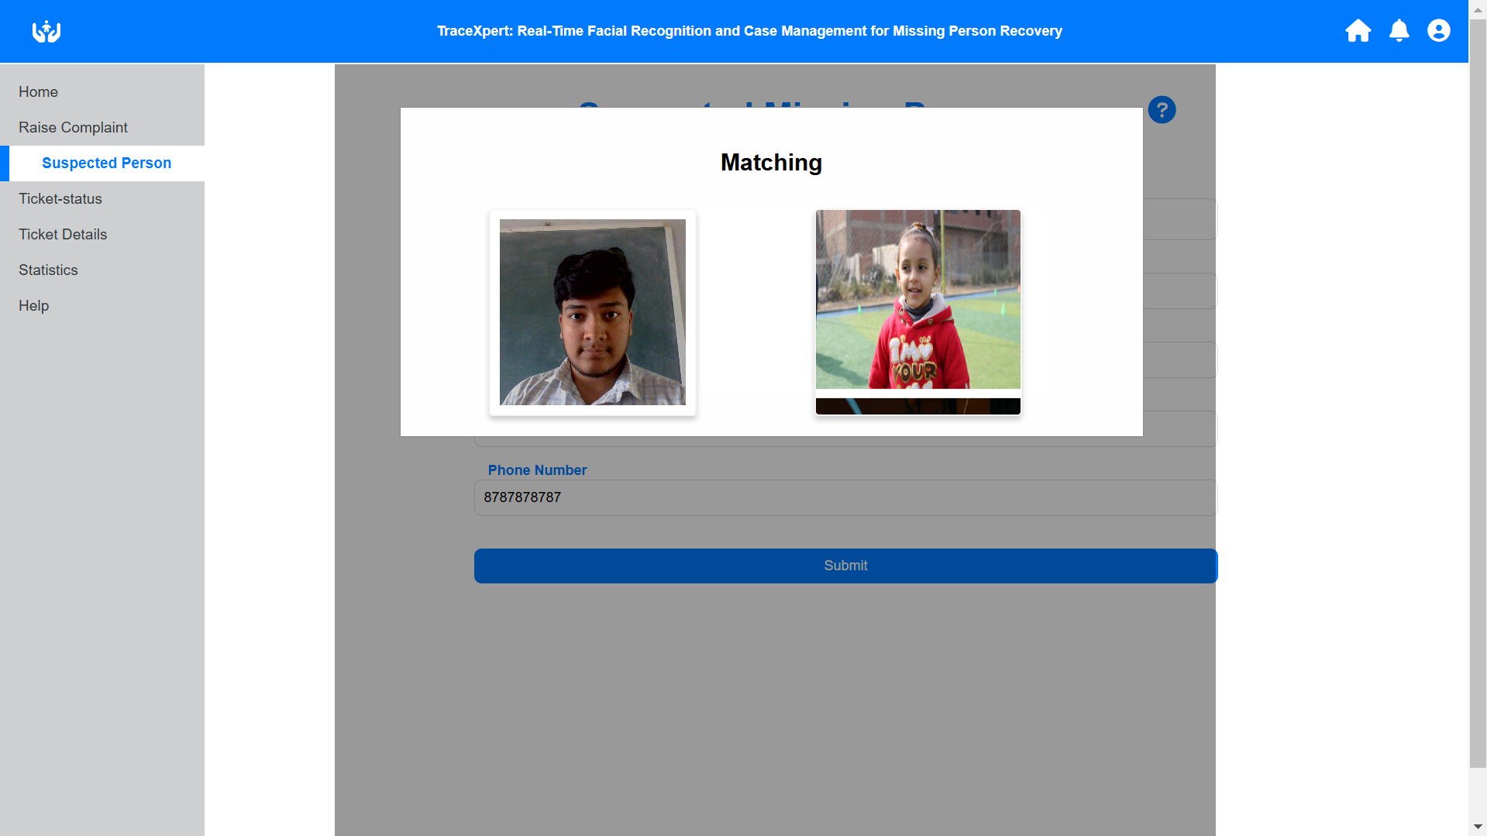
27. Searches the uploaded image in complaint data

Slide 32
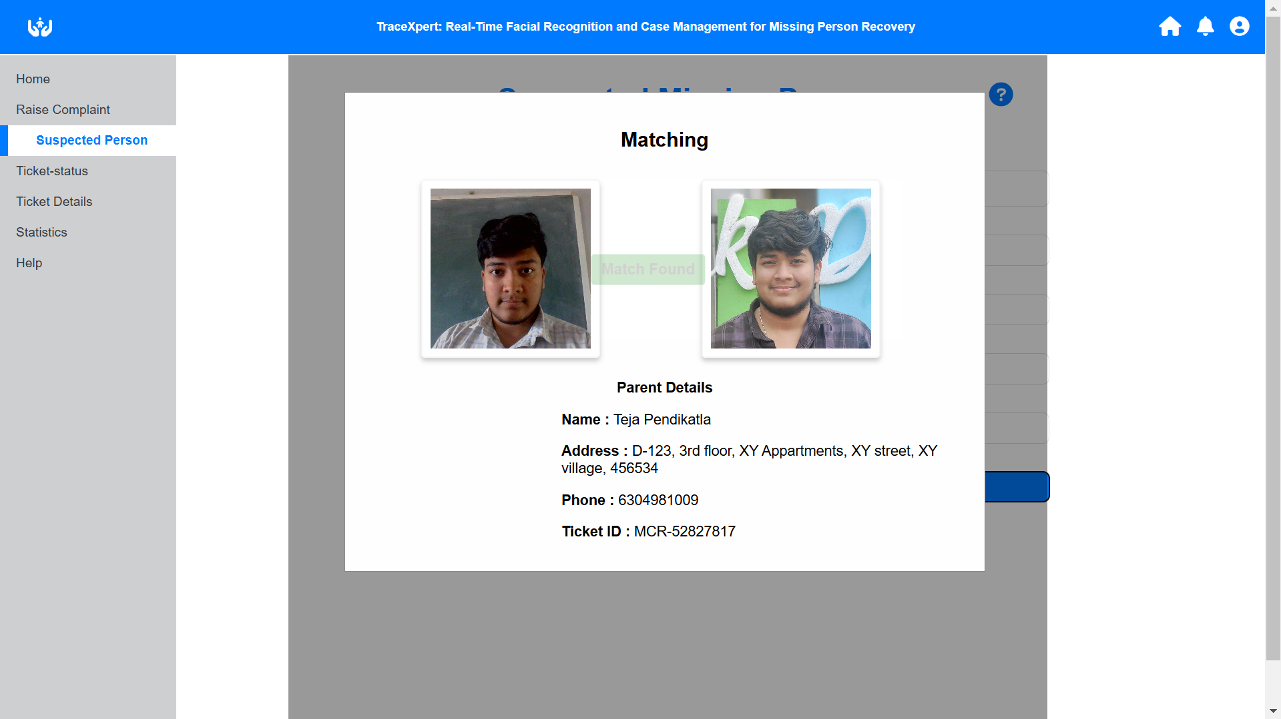
28. Match found for our complaint.

Slide 33
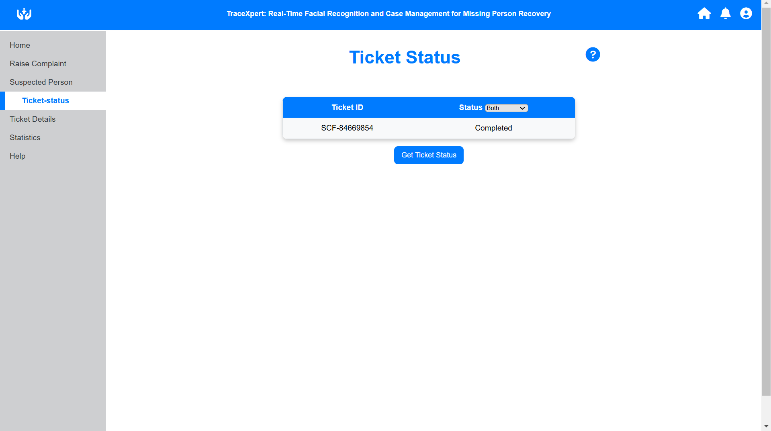
29.Search the ticket for status

Slide 34
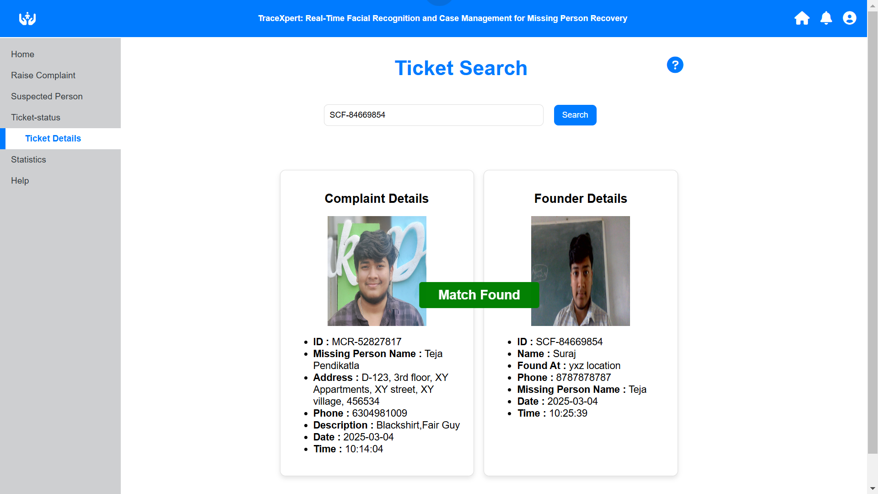
30. Search with ticket id for more details

Slide 35
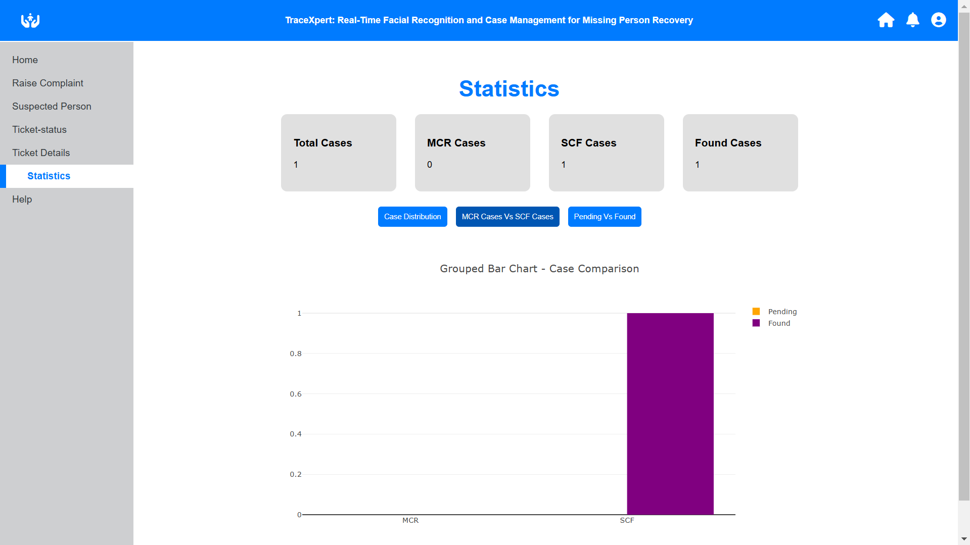
31. User statistics of def@gmail.com

Slide 36
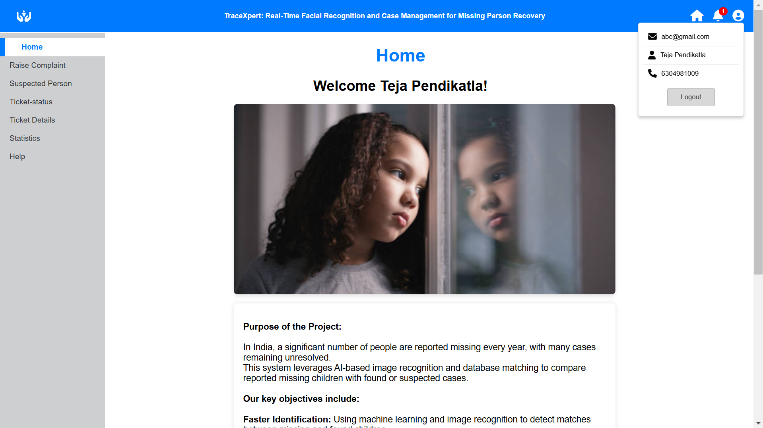
32.Login back to abc@gmail.com , you get notification for match found

Slide 37
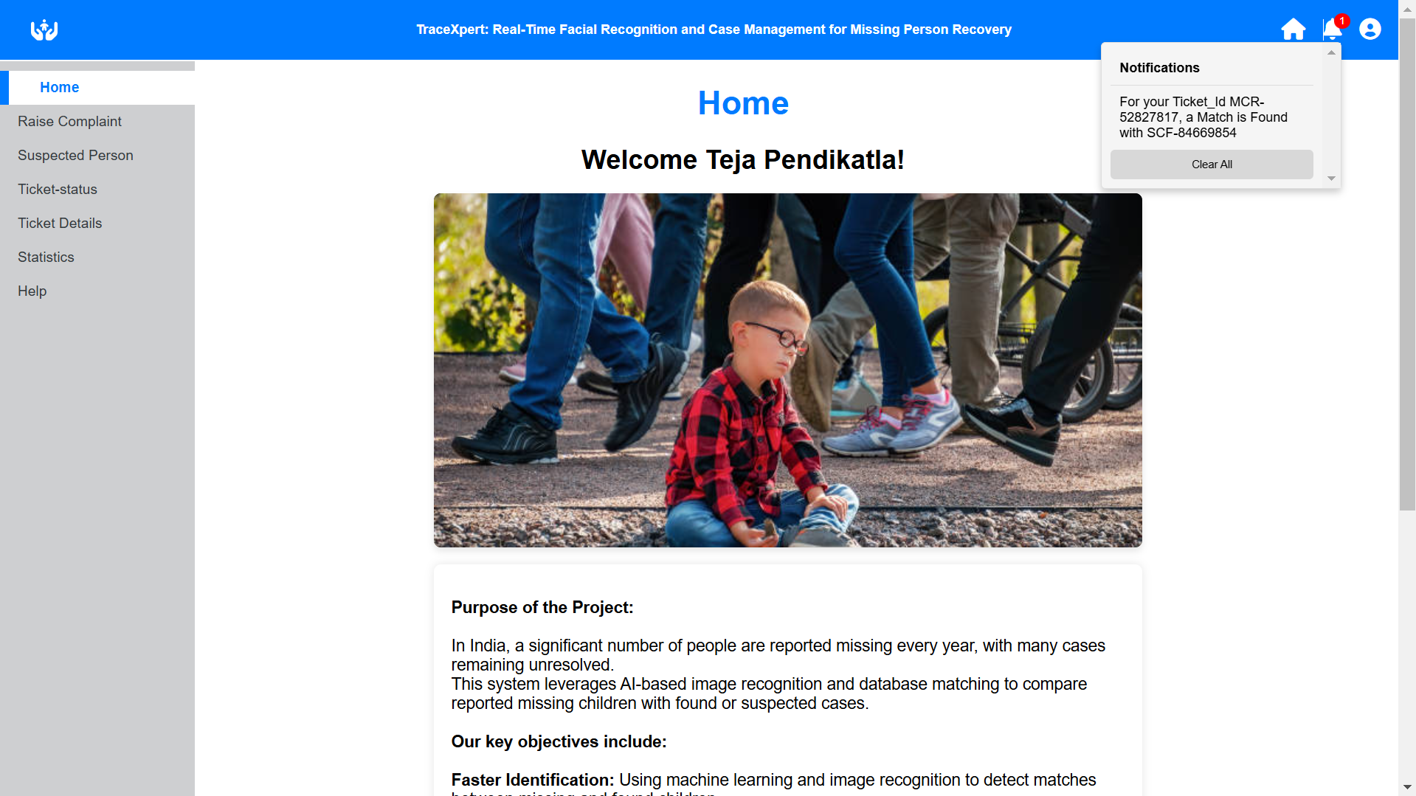
33. Notification to our raised complaint

Slide 38

34. Login to admin dashboard

Slide 39
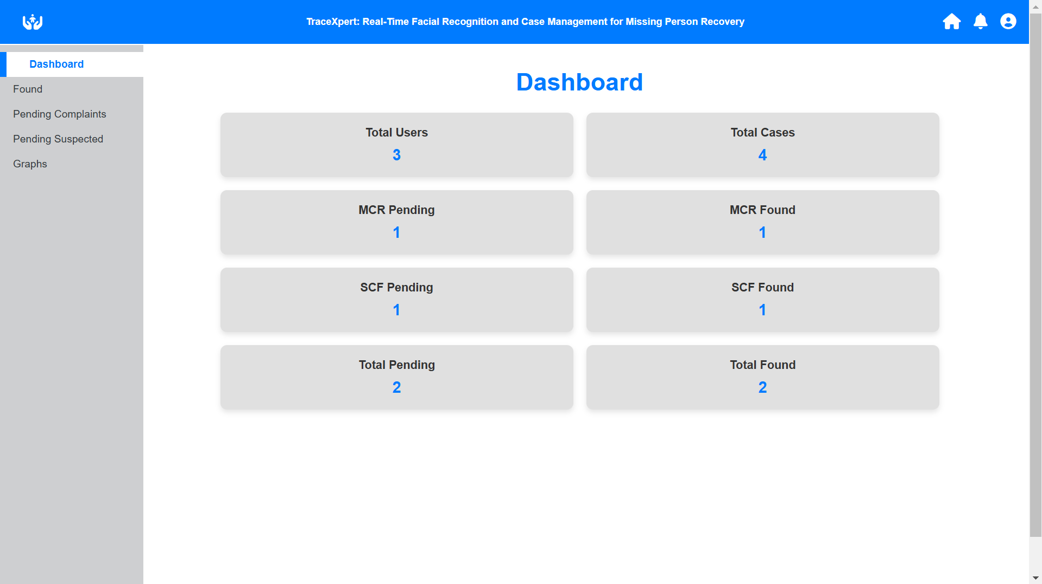
35.Admin dashboard

Slide 40
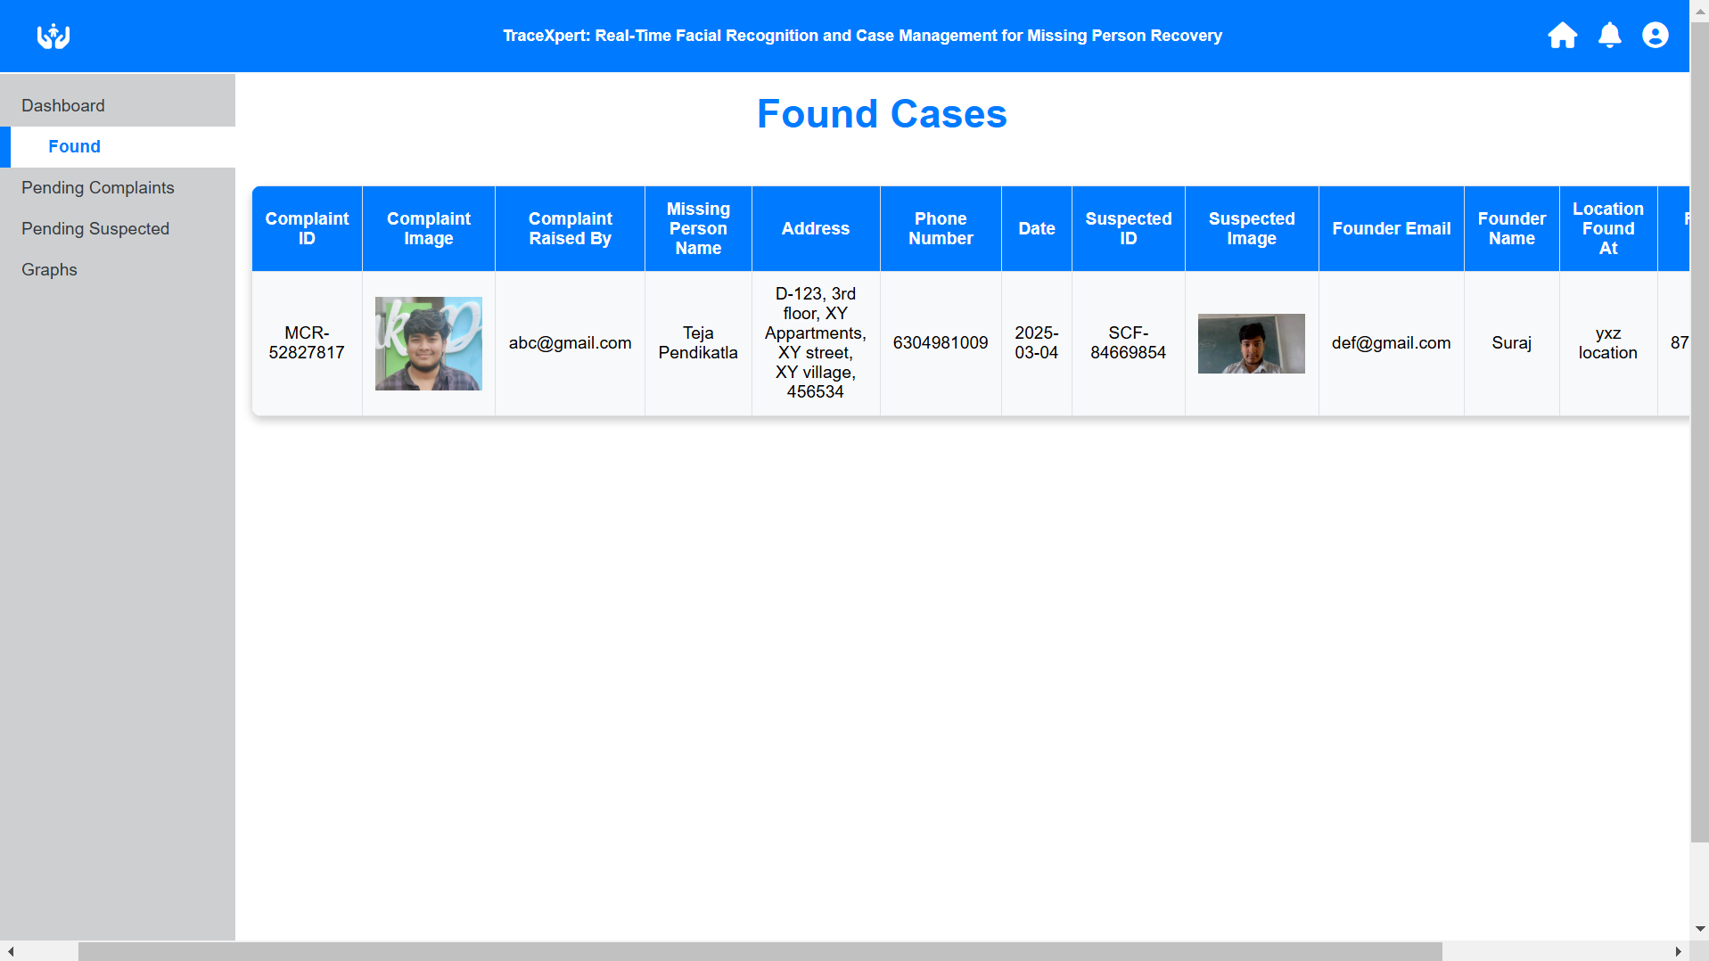
36. Match Found data of all accounts

Slide 41
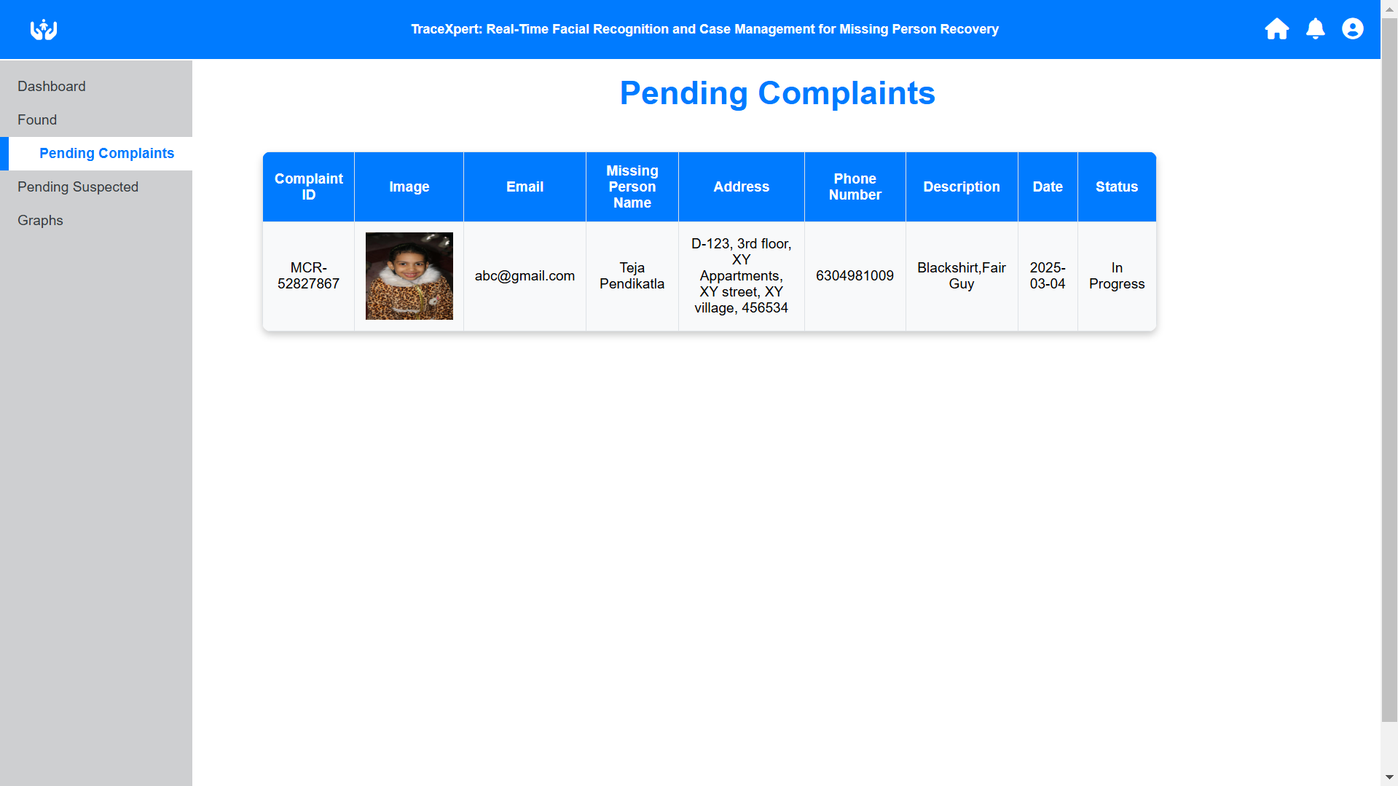
37.Pending raise complaints of all accounts

Slide 42
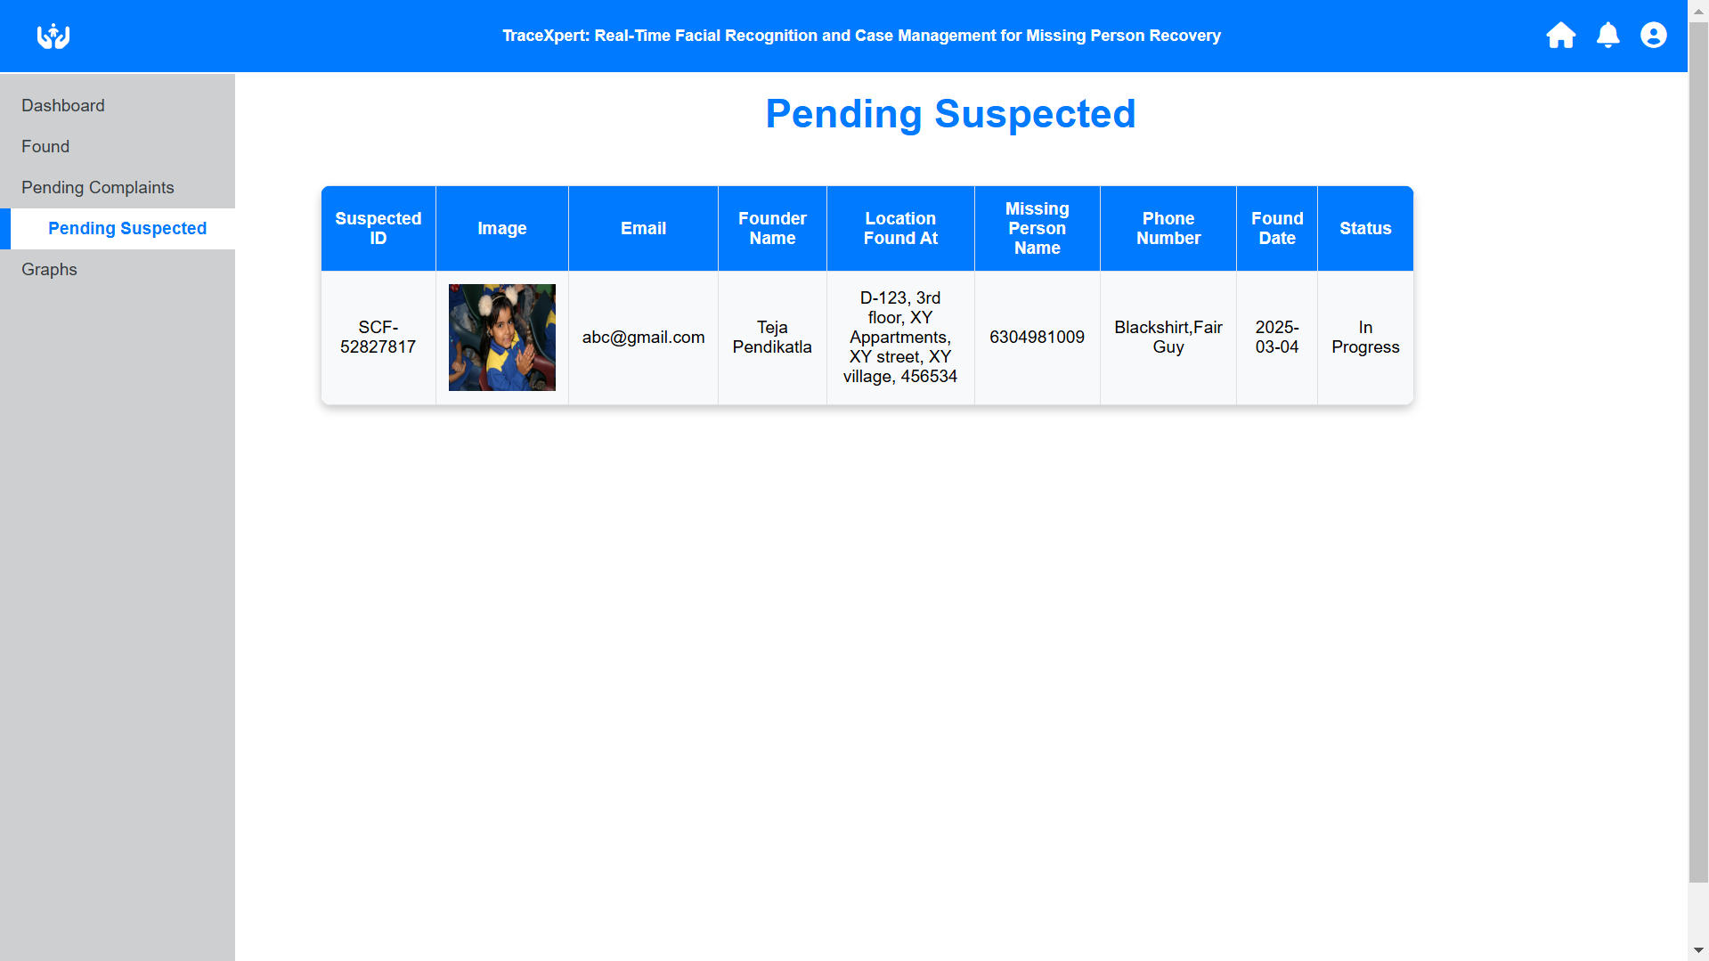
38.Pending suspected missing person of all accounts

Slide 43
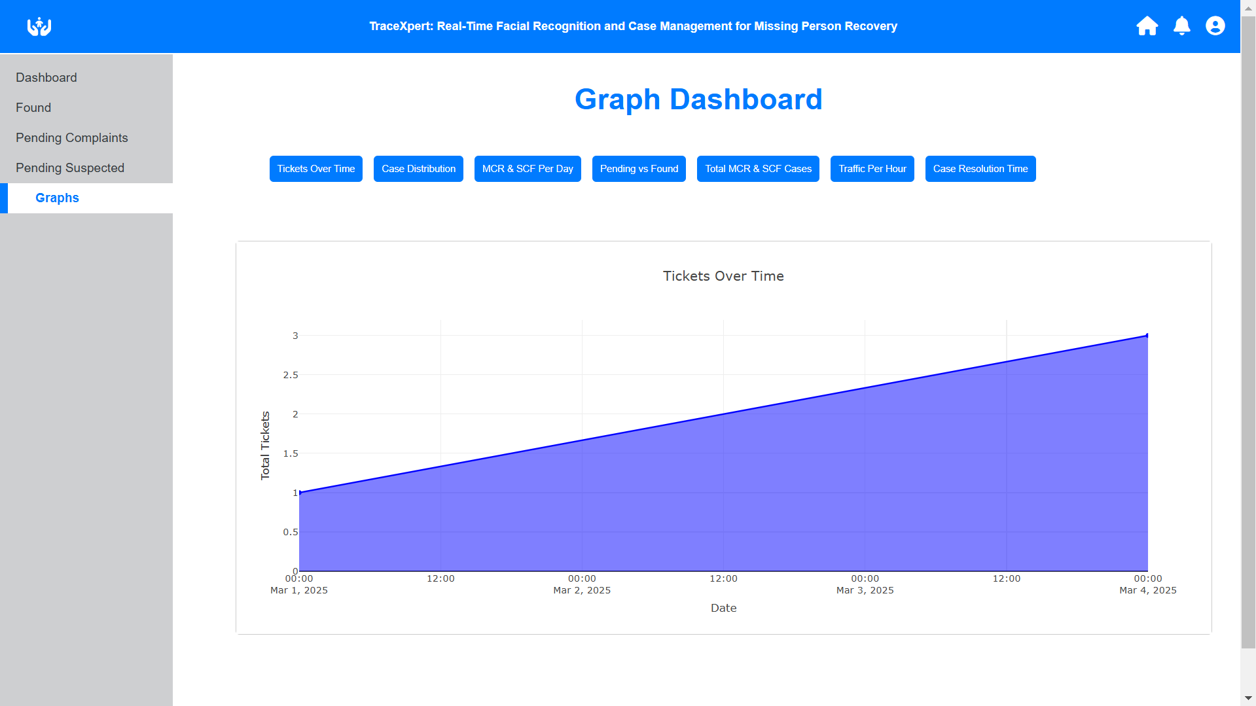
39. Area Map for tickets day by day

Slide 44
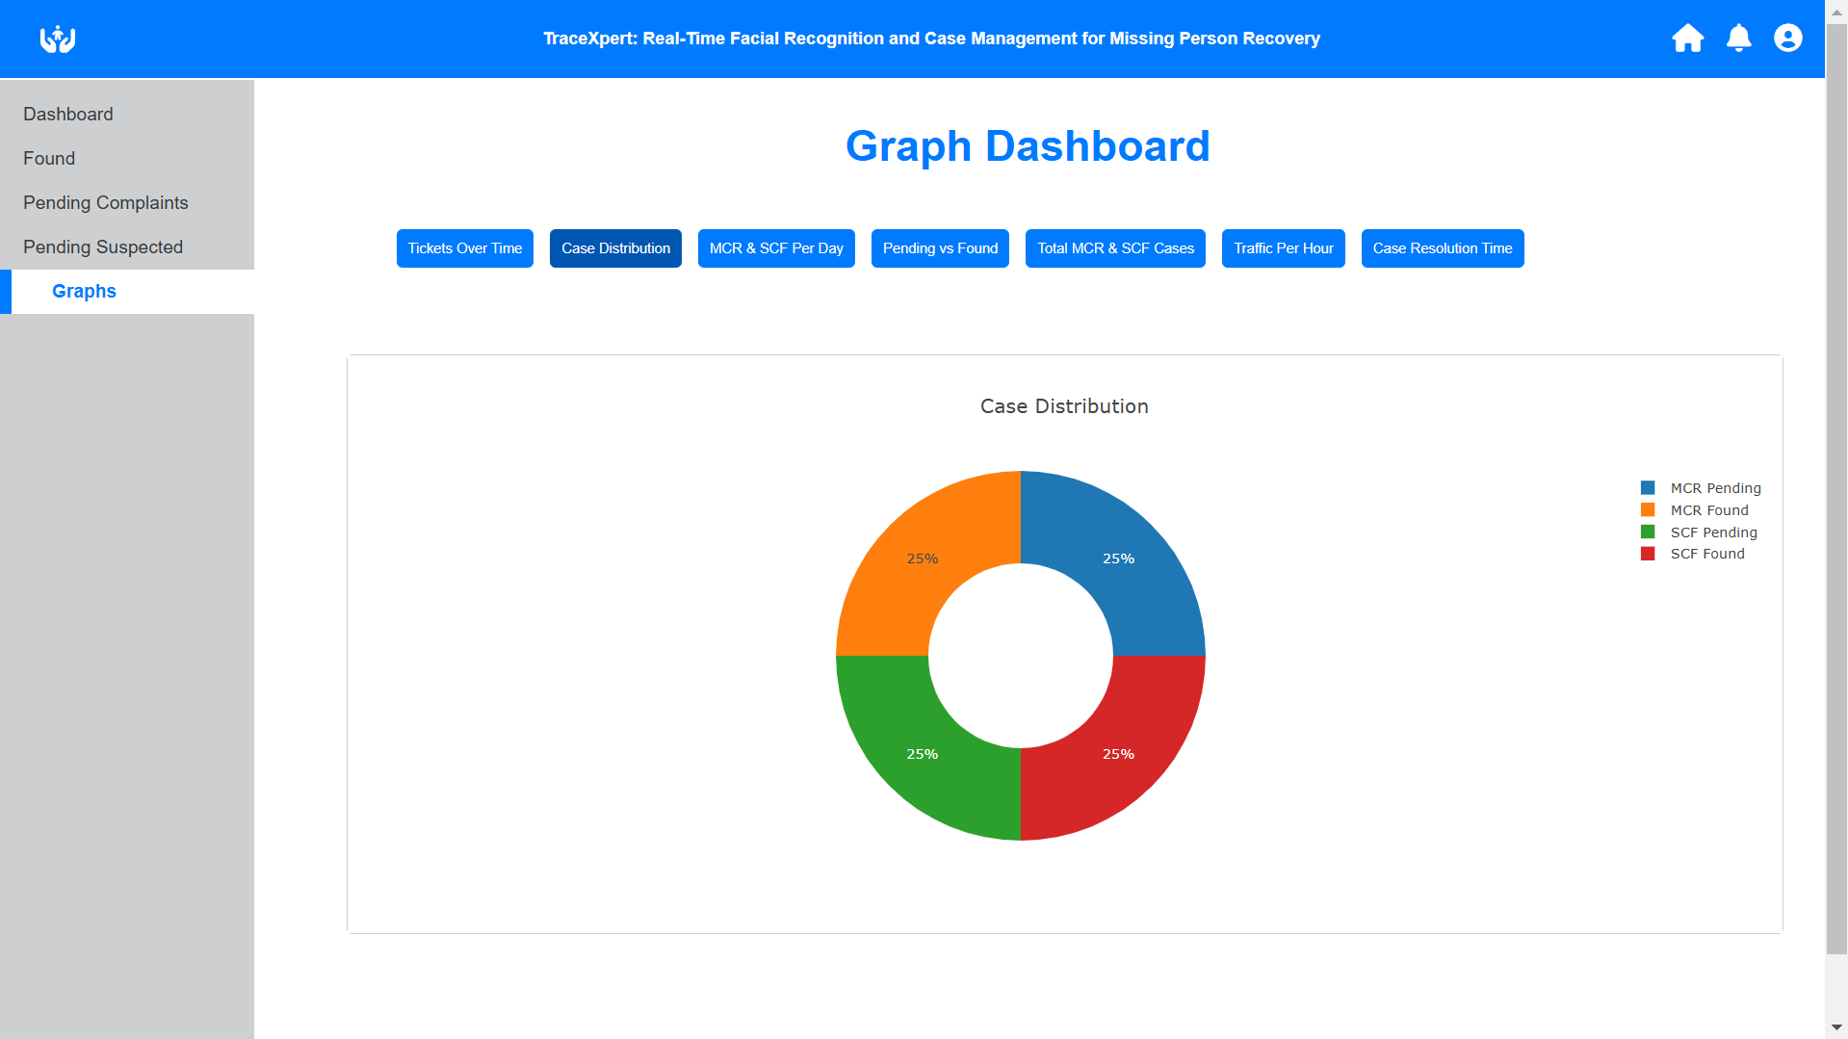
40. Donut chart for case distribution

Slide 45
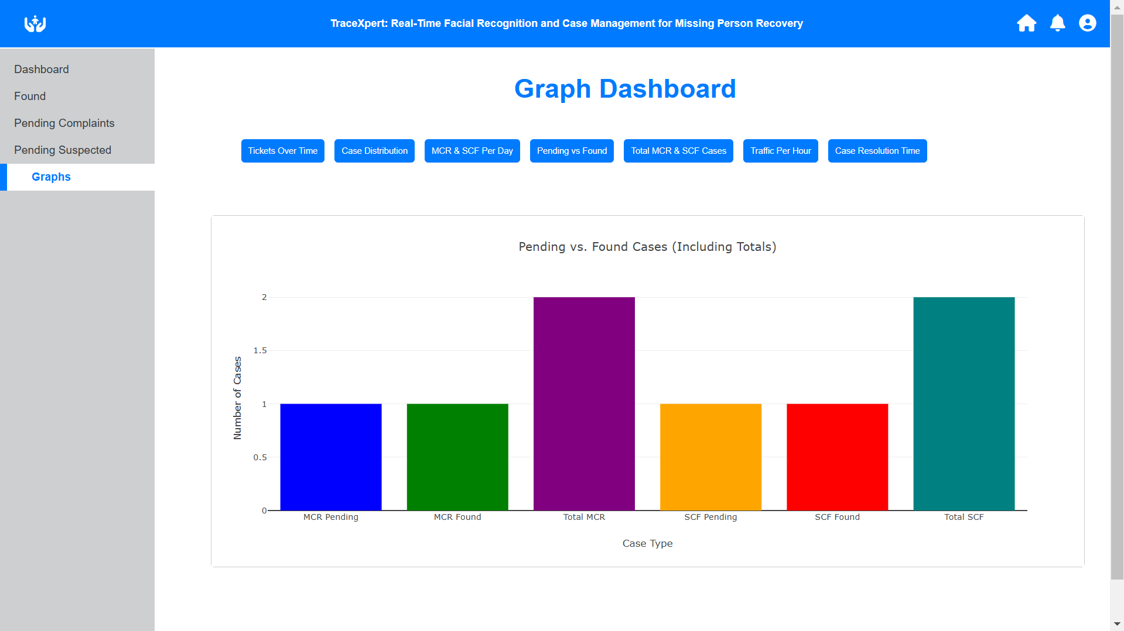
41.Bar graphs for all tickets of all accounts

Slide 46
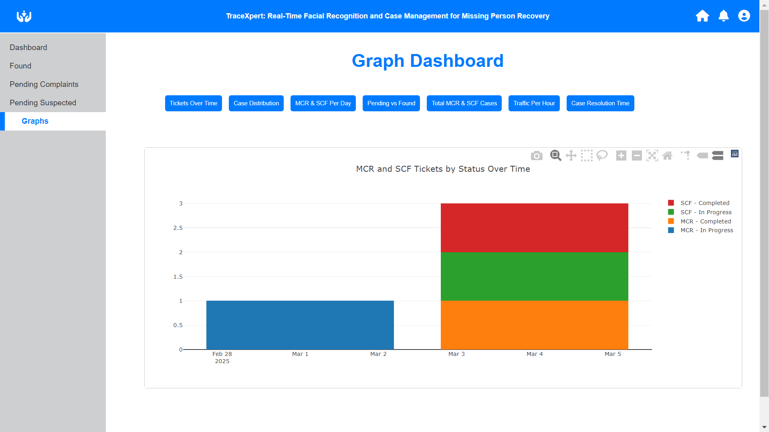
42. Case distribution per day

Slide 47
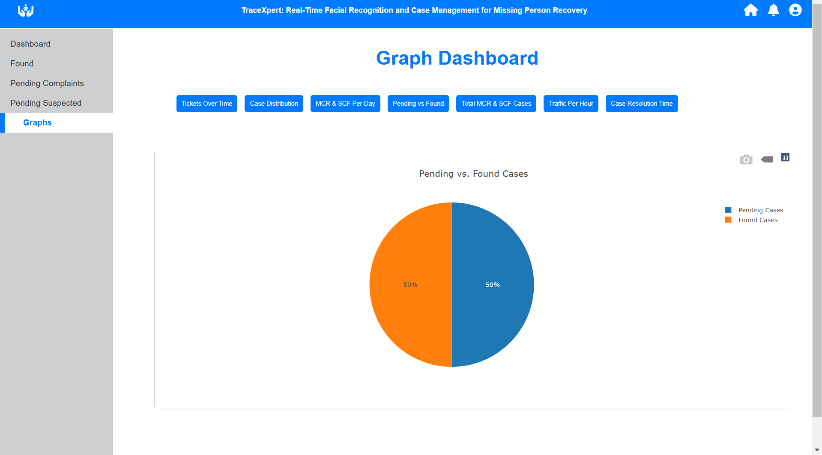
43. Pie chart for pending/completed of all accounts

Slide 48
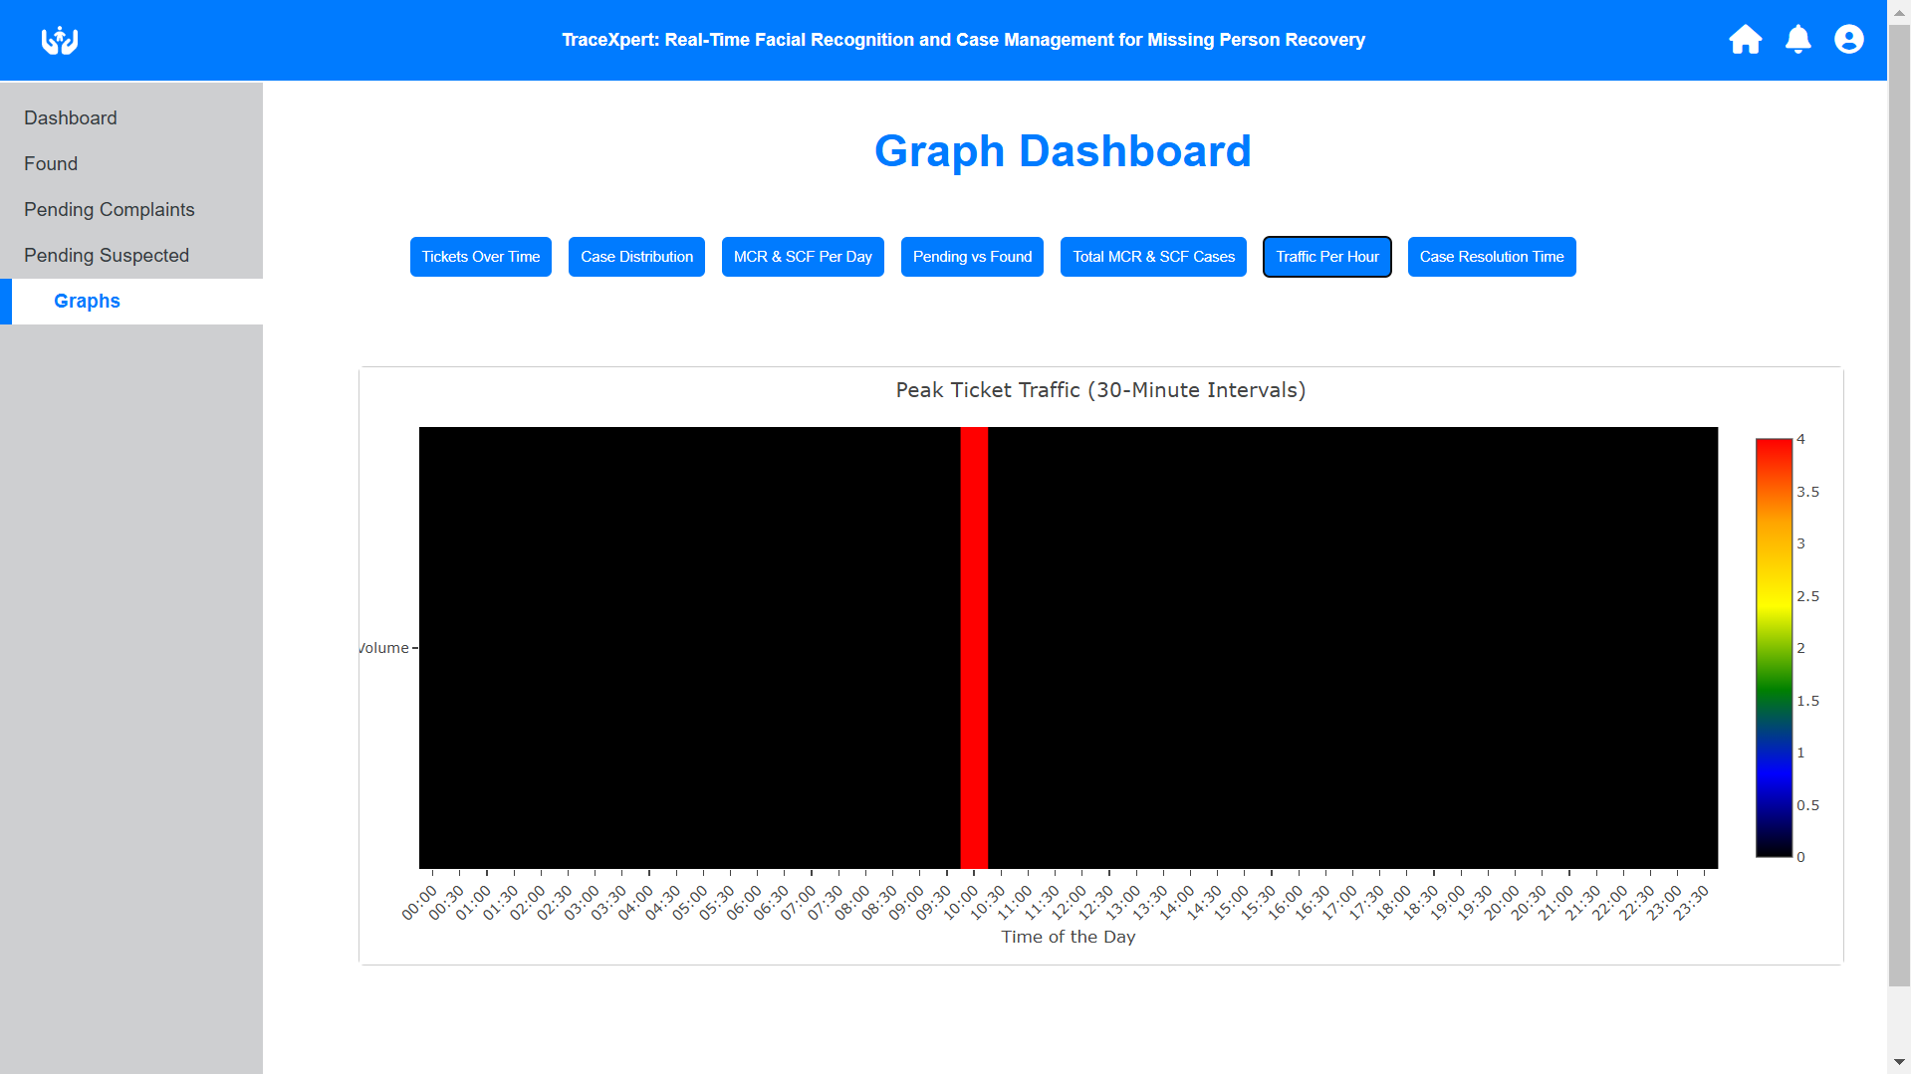
44.Heat map per every ½ hr showing the most traffic hours

Slide 49
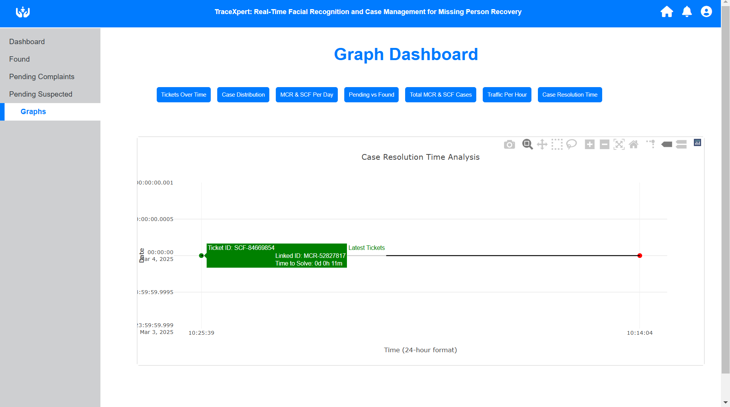
45. Resolving time for a ticket.

Slide 50
Conclusion
Trace Master tackles the rising crisis of missing persons due to human trafficking, kidnappings, disasters, and mental health issues by integrating deep learning, real-time facial recognition, and intelligent case management.
Using Insight Face and Arch Face for face feature extraction and Cosine Similarity for precise face matching, it ensures scalable, adaptable identification under varied conditions like poor lighting and aging.
It enables real-time scanning of millions of images, significantly reducing search times. The centralized case management system enhances tracking, alerts, and cross-agency collaboration, making recovery efforts more effective. While privacy and ethical concerns remain crucial, AI advancements and responsible deployment position Trace Master as a life-saving technology, bridging innovation and humanitarian efforts for a safer, more connected world.

